Slide 1

Exploratory Data Analysis
Benefits, Techniques, and Examples

Slide 2
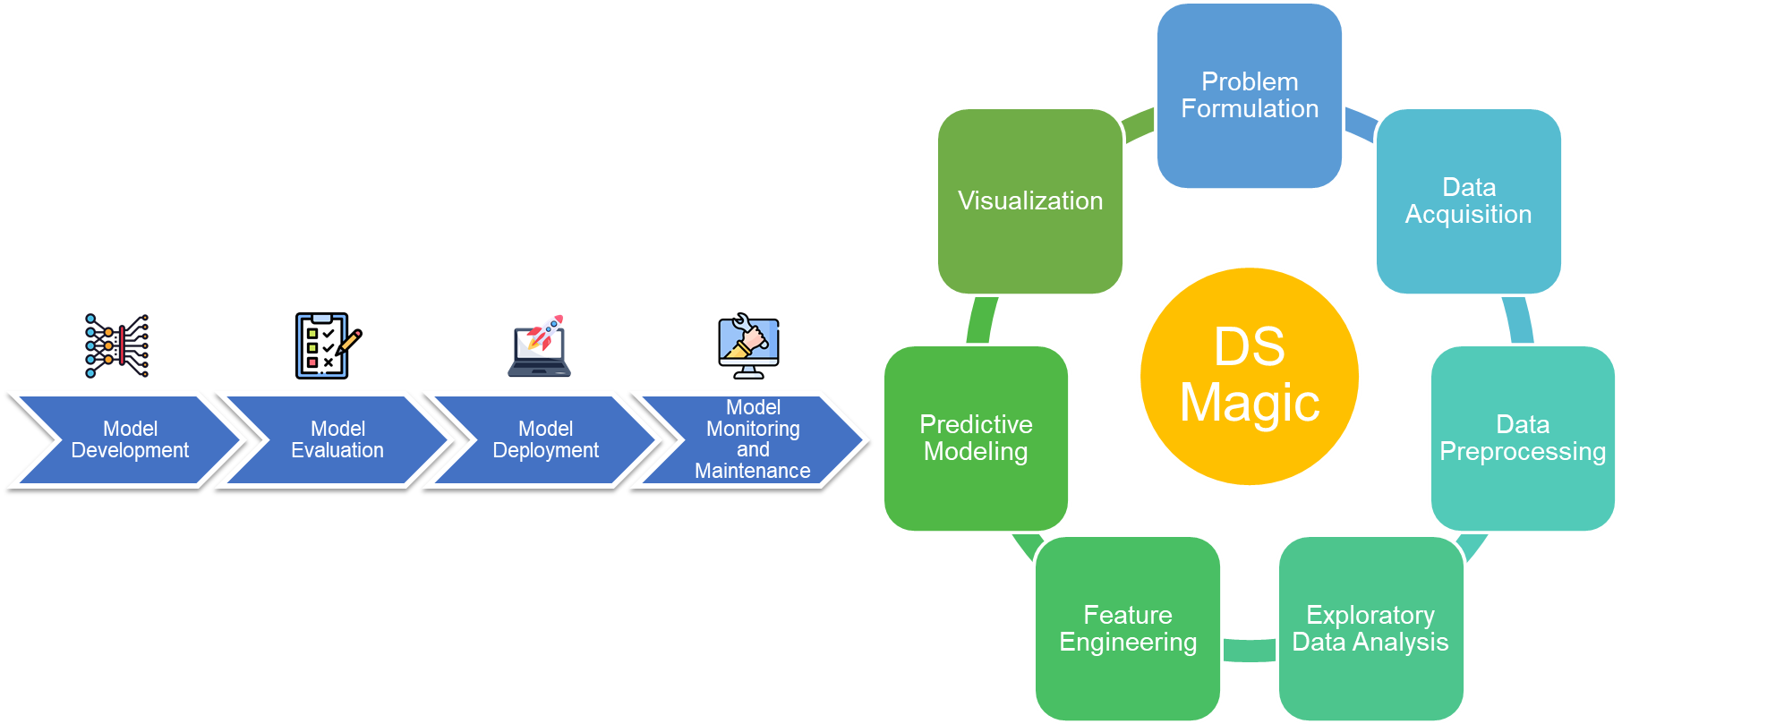
Recall
Identifying the Right Data
Clean the Data
What is in the data?

Slide 3

What is Exploratory Data Analysis?
Exploratory Data Analysis: EDA
An approach
a precursor to more complex data analysis techniques
such as regression analysis, cluster analysis, and machine learning
Self-Study: https://www.itl.nist.gov/div898/handbook/eda/eda.htm
Notes:
parsimonious : Using a minimal number of assumptions, steps, or conjectures.

Slide 4
Why EDA?
Primary Goal
Insight into the Data
Secondary Goals
A good-fitting, parsimonious model
Outliers
Robustness of conclusions
Estimates for parameters
Uncertainties for those estimates
A ranked list of important factors
Statistical significance of conclusions
Optimal settings

Slide 5
What are other EDA approaches?
Start with a general science/engineering problem and all yield science/engineering conclusions.
Classical
such as summary statistics and hypothesis testing
analyze data in a structured manner
useful for answering specific research questions
do not provide a comprehensive understanding of the data.
Bayesian
analyze data by incorporating prior knowledge and beliefs.
useful for making predictions and updating beliefs
require a strong understanding of probability theory and can be computationally intensive.
Exploratory (EDA)

Slide 6
How Does Exploratory Data Analysis differ from Classical Data Analysis?
Classical Analysis
Problem
Data
Model
Analysis
Conclusions
Bayesian
Problem
Data
Model
Prior Distribution
Analysis
Conclusions
EDA
Problem
Data
Analysis
Model
Conclusions
In the real world, data analysts freely mix elements of all of the above three approaches (and other approaches)

Slide 7
Techniques for EDA
Univariate Analysis
Bivariate Analysis
Multivariate Analysis
Correlation and Regression Analysis
Cluster Analysis
Time Series Analysis
Principal Component Analysis
Factor Analysis
Discriminant Analysis
Canonical Correlation Analysis
Spatial Analysis
Text Analysis
Network Analysis

Slide 8
Univariate Analysis
A statistical technique in data analysis that involves the examination and evaluation of a single variable in isolation.
Primarily concerned with understanding the characteristics, distribution, and properties of one variable at a time.
Provides a foundational and fundamental understanding of individual variables.

Slide 9
Objectives
Following are the objectives of Univariate analysis:
Descriptive Statistics
Data Understanding
Data Visualization

Slide 10
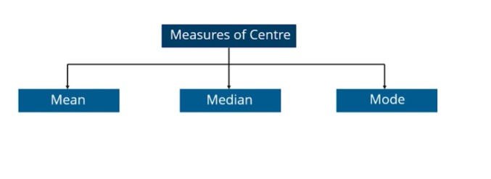
Descriptive Statistics
The primary objective of univariate analysis is to compute and report descriptive statistics for a single variable.
Descriptive statistics are broken into two categories:
Measures of central tendencies
Measures of variability

Slide 11
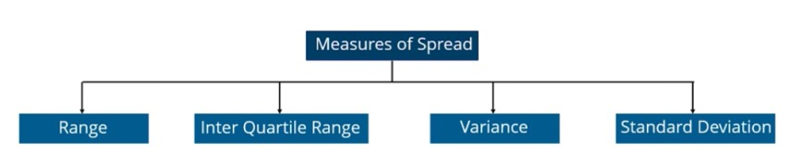
Descriptive Statistics
The primary objective of univariate analysis is to compute and report descriptive statistics for a single variable.
Descriptive statistics are broken into two categories:
Measures of central tendencies
Measures of variability

Slide 12
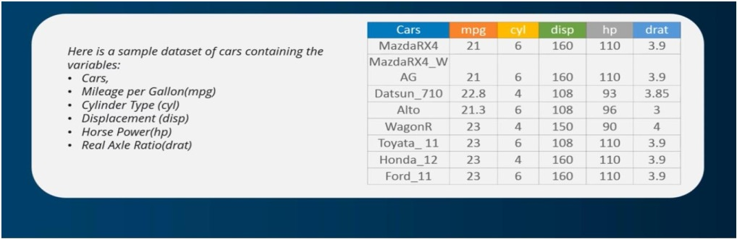

Measures of Central Tendencies-Mean
To find out the average of the horsepower of the cars among the population of cars, we will check and calculate the average of the values:

Slide 13
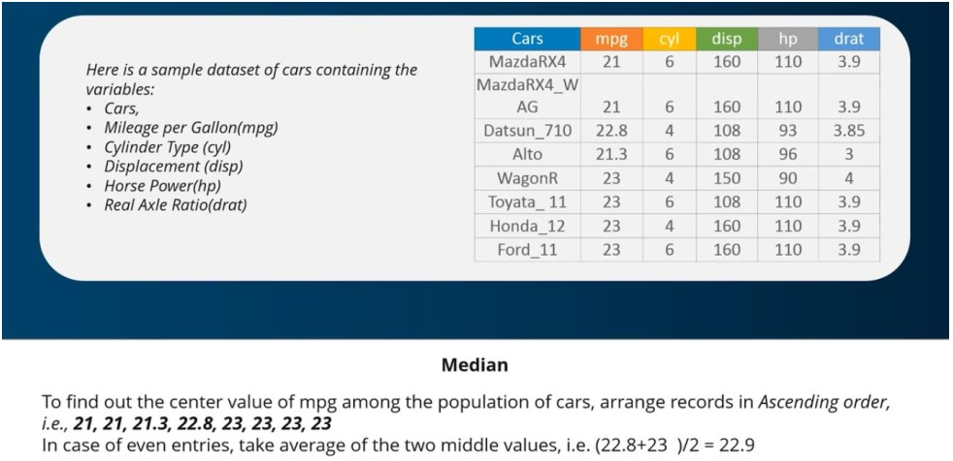
Measures of Central Tendencies-Median

Slide 14
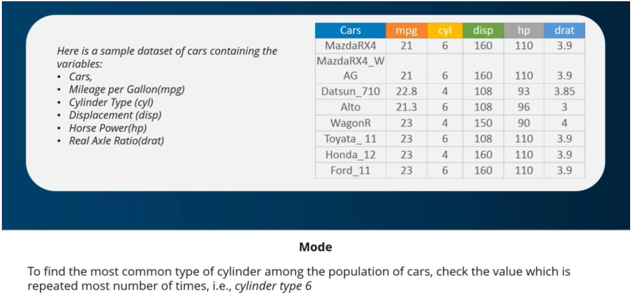
Measures of Central Tendencies-Mode

Slide 15
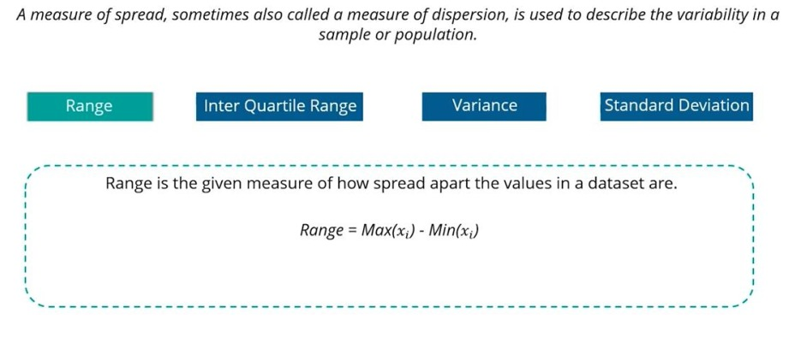
Measures of Spread-Range

Slide 16
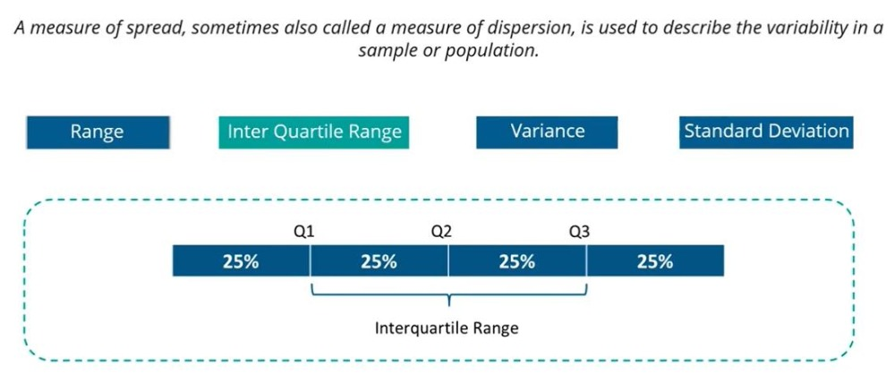
Measures of Spread-Quartiles

Slide 17
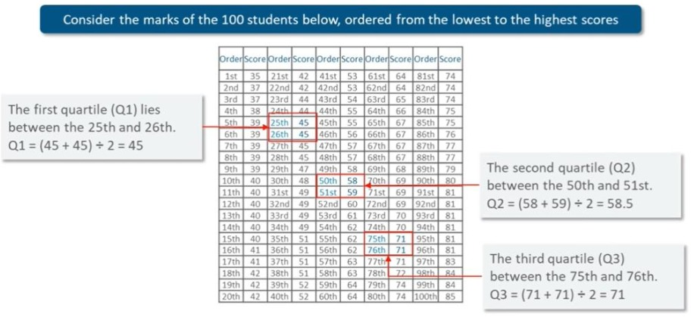
Measures of Spread-Quartiles(IQR Calculation)

Slide 18
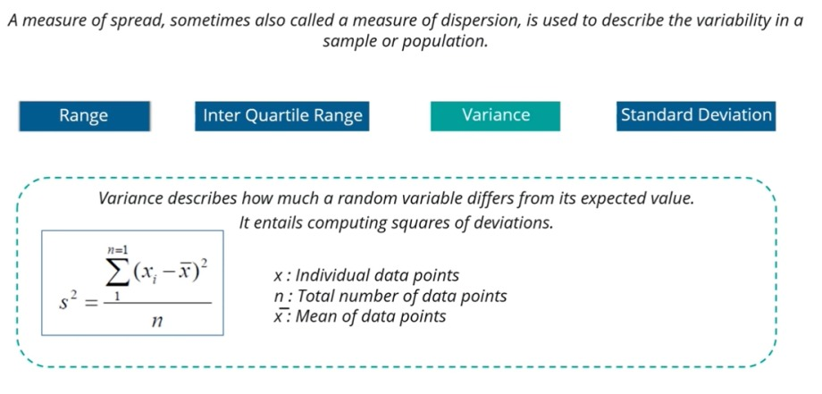
Measures of Spread-Variance

Slide 19
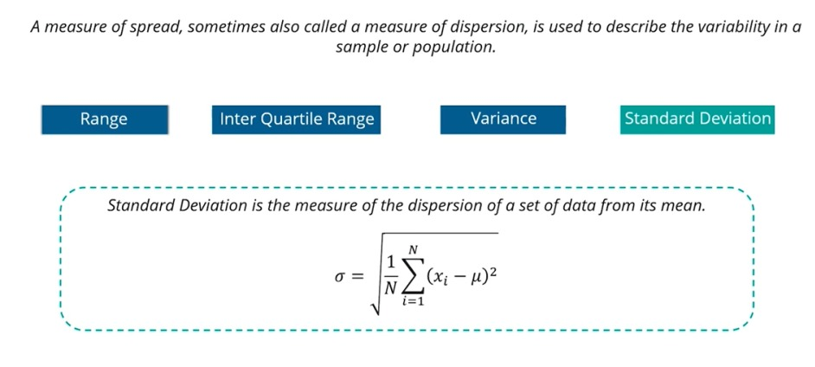
Measures of Spread-Standard deviation

Slide 20
Data Understanding
Data understanding in univariate analysis is a crucial step.
Univariate analysis focuses on examining and understanding a single variable at a time
Here are the key steps for data understanding in univariate analysis:
Data Collection
Data Inspection
Data Cleaning

Slide 21
Bivariate Analysis
A statistical method used in data analysis to examine and understand the relationship, association, or interaction between two different variables.
It involves the simultaneous analysis of two variables, which can be numerical or categorical.
It explores how changes in one variable are associated with changes in another variable.

Slide 22
Types of Bivariate Analysis
Bivariate analysis involves examining the relationships or associations between two different variables.
The type of bivariate analysis you choose depends on the nature of the variables you're working with.
Here are the common types of bivariate analysis:
Numerical-Numerical Analysis
Categorical-Categorical Analysis
Categorical-Numerical Analysis

Slide 23
Numerical-Numerical Analysis
Numerical-numerical bivariate analysis, also known as correlation analysis, is a statistical technique used to examine the relationship between two numerical variables.
The primary goal is to understand whether and to what extent the two variables are related and the nature of that relationship.
Correlation analysis quantifies the strength, direction, and linearity of the relationship between these variables.

Slide 24
Steps for Numerical-Numerical Analysis
Choose the variable
Visualize the data
Calculate the Correlation Coefficient
Pearson Correlation Coefficient (r)
Spearman Rank Correlation

Slide 25
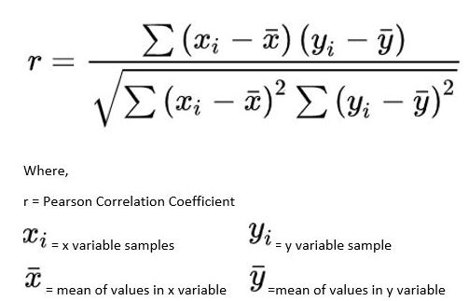
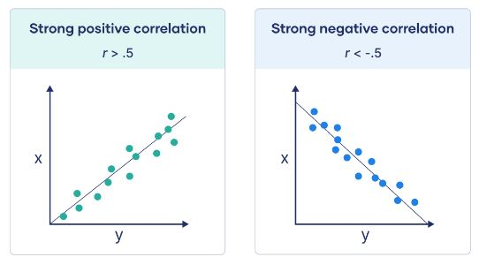
Pearson Correlation Coefficient(r)
Measures the linear relationship between two variables. It ranges from -1 (perfect negative correlation) to 1 (perfect positive correlation), with 0 indicating no linear correlation.

Slide 26

Sample Data

Slide 27
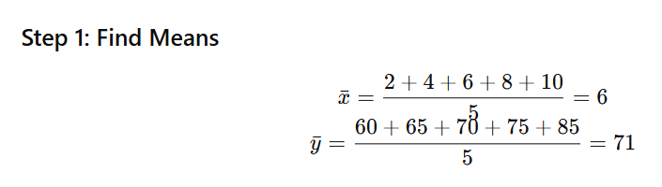
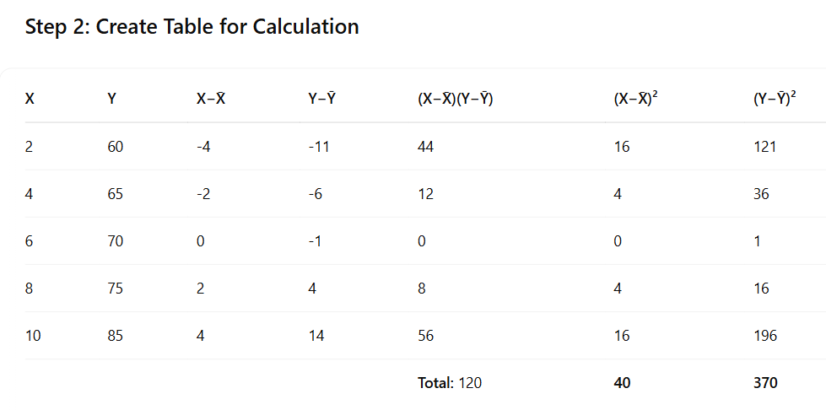
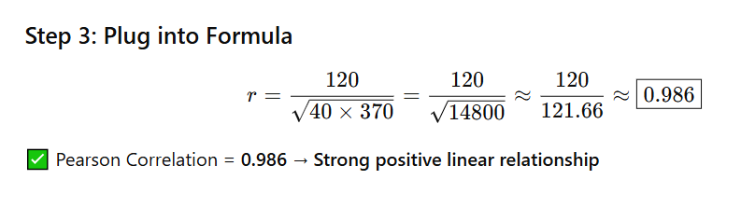
Pearson Correlation

Slide 28
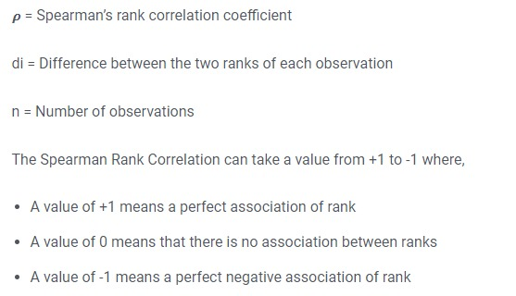
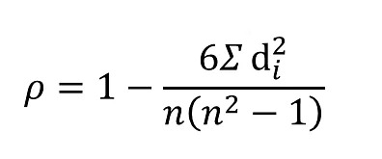
Spearman Rank Correlation
Measures the monotonic (non-linear) relationship between two variables based on their ranked values. It's more robust to outliers and non-linear relationships.

Slide 29
Calculate the Spearman Rank Correlation Coefficient between X and Y using the following dataset. Interpret the result.
x | Y
28.76 | 95.68
78.83 | 45.33
40.9 | 67.76
88.3 | 57.26
94.05 | 10.29
4.56 | 89.98
52.81 | 24.61
89.24 | 4.21
55.14 | 32.79
45.66 | 95.45

